Slide 1
Cohort Entry Date
(xxxxxxx)
Day 0
Exclusive assessment window
(xxx)‡
Days [-x, -x]
Covariate assessment window
(xxx)*
Days [-x, -x]
Covariate assessment window
(xxx)+
Days [-xxx, -x]
Covariate assessment window
(xxx)†
Days [-xxx, -x]
Follow-up window
Days [0, censor]#
Month DD, YYYY
Month DD, YYYY
Notes:
Time windows: Separate boxes, Placed in different rows to distinguished overlap
Columns: Indicate a date on the patient timeline

Slide 2
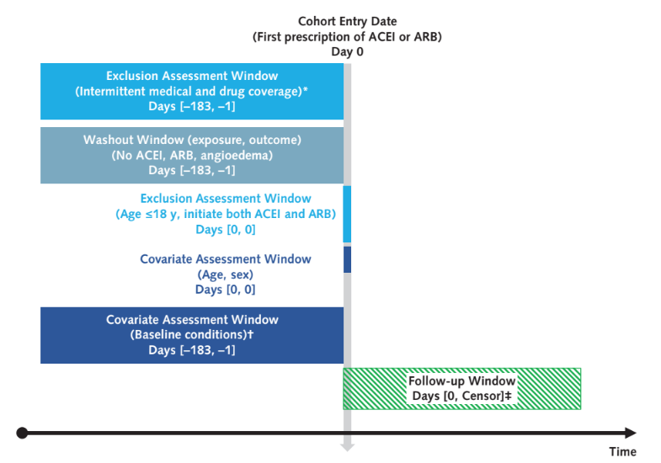
study design diagram
Exposure-based cohort
Sequential steps from top to bottom
Ann Intern Med 2019;170(6):398-406
Notes:
Construir um template p isto
Exposure-based cohort

Slide 3
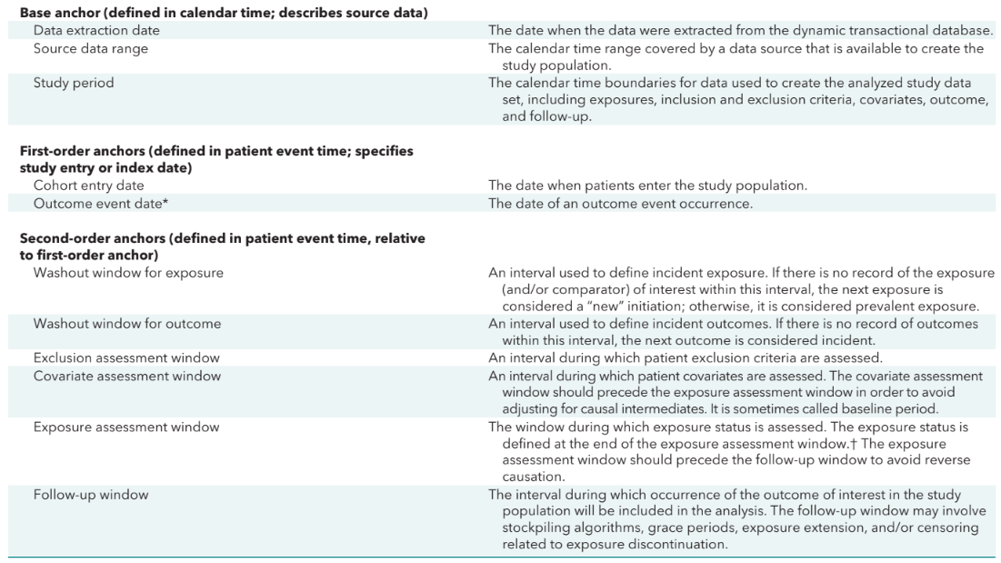
study design diagram
Columns
Indicate a date on the patient timeline
Time windows
Separate boxes
Placed in different rows to distinguished overlap
Ann Intern Med 2019;170(6):398-406
Notes:
Construir um template p isto

Slide 4
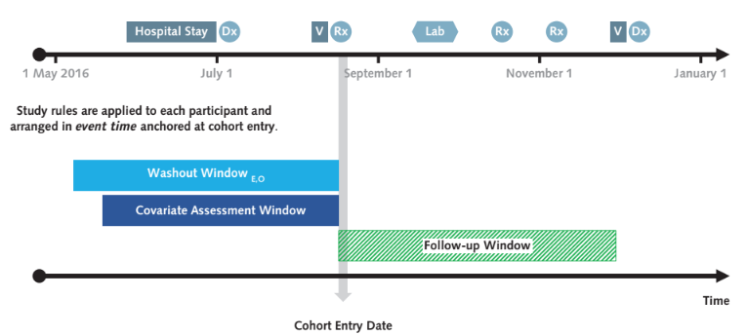
study design diagram
Transactional data
Study
implementation
/Index date
Ann Intern Med 2019;170(6):398-406
Notes:
information that may be conceptualized as characterizing a point in time, such as baseline patient characteristics before the start of exposure, is actually recorded during a time window through a series of encounters.
When an effectiveness or safety study is implemented in a longitudinal database, the time scale shifts from calendar time to patient event time.
Specific algorithms define events in the patient timeline.
CED is considered a first-order anchor because most other anchors and parameters used in study implementation will be defined relative to it. The CED is de-
fined by an inclusion rule, along with multiple exclusion criteria that are sequentially applied.
a cohort study looking at risk for cardiovascular outcomes in patients after percutaneous coronary intervention or acute coronary syndrome defined
the CED as the date of hospital discharge
In many applications, we want to make sure that the outcome of interest has not yet occurred at the time of study entry.

